Slide 1
Integrating Data Analytics & Knowledge Management - A Conceptual Model
58th Annual Conference, Clearwater Beach, Florida, USA, Oct 3 – 6, 2018
International Association of Computer Information Systems (IACIS)
Jay Wang
The MITRE Corporation, cjwang@mitre.org
Robert Morris University, cxwst212@mail.rmu.edu
October, 2018
The author's affiliation with The MITRE Corporation is provided for identification purposes only, and is not intended to convey or imply MITRE's concurrence with, or support for, the positions, opinions, or viewpoints expressed by the author. Approved for Public Release; Distribution Unlimited. Case Number 18-3110. ©2018 The MITRE Corporation. ALL RIGHTS RESERVED.
Notes:
This presentation summarizes a research paper of the same title published in volume 19, issue 2 of Issues in Information Systems (IIS).
The paper can be retrieved from the following link:
http://www.iacis.org/iis/iis_articles.php?volume=19&issue=2
Need to add your MITRE email address with an asterisk so you can add the disclaimer shown at the bottom
*The author's affiliation with The MITRE Corporation is provided for identification purposes only, and is not intended to convey or imply MITRE's concurrence with, or support for, the positions, opinions or viewpoints expressed by the author.

Slide 2
Many Synonyms for Data Analytics
Data Mining
Knowledge Discovery in Databases (KDD)
Business Analytics
Business Intelligence
Informatics
Machine Learning
Big Data Analytics
Data Science
“The extensive use of data, statistical and quantitative analysis, explanatory and predictive models, and fact-based management to drive decisions and actions” (Davenport & Harris, 2007)
Notes:
There are many similar terms to describe the process of gaining insights from data using computing power. We will use data analytics as a generic umbrella term through out.
There are differences between data analytics and inferential statistics. Davenport and Harris’s definition provides some hints. The former uses large amounts of data and aims to drive decisions and actions. The latter uses limited amounts of data and aims to infer theory about a population from a sample.

Slide 3
Two Definitions of KM
“A discipline that promotes an integrated approach to identifying, capturing, evaluating, retrieving, and sharing all of an enterprise’s information assets. These assets may include databases, documents, policies, procedures, and previously un-captured expertise and experience in individual workers” (Duhon, 1998, p. 12)
“Any process or practice of creating, acquiring, capturing, sharing and using knowledge, wherever it resides, to enhance learning and performance in organizations” (Scarborough, Swan, and Preston, 1999, p.669)
Notes:
Knowledge management is a separate discipline from data analytics but these two are intersecting.
KM does not have many synonyms, but is not short of definitions. Two representative ones are shown here.
The takeaways here are that an individual’s expertise and experience are invaluable assets of an organization and KM is about organizational learning to improve performance.

Slide 4
DIKW Hierarchy (Rowley, 2007)
Wisdom
Knowledge
Information
Data
Increasing Understanding
Decreasing Tangibility
Notes:
The DIKW (Data, Information, Knowledge, Wisdom) pyramid represents the whole spectrum of human experience and pursuit of knowledge.
It is a simple yet powerful model, second to the Yin and Yang model.
The Yin and Yang model helps us understand and explain the natural and social world.
The DIKW model helps us understand and explain our cognitive/mental world.
As we move up the hierarchy from data to wisdom, our understanding of the world increases. At the same time, our knowledge about the world become less tangible and more embodied within us.

Slide 5
Three Perspectives of DIKW Hierarchy
DIKW Construct | Ackoff (1989) - Information processing | Davenport and Prusak (1998) – Knowledge management | Zeleny (2006)
Data | Symbols | A set of discrete, objective facts about events | Know nothing
Information | Data that are processed to be useful; provides answers to who, what, where and when questions | Data that makes a difference | Know what
Knowledge | Application of data and information | Derives from minds at work | Know how
Wisdom | Evaluated understanding | Higher-order concept lumped into knowledge for practical purpose | Know why
Notes:
DIKW hierarchy is a well established model in the information systems research.
Ackoff’s view represents the perspective of information processing which emphasizes the use of technology
Davenport & Prusak’s view represents the perspective of knowledge management which emphasizes the role of human minds.
Zeleny’s description is simple and interesting.

Slide 6
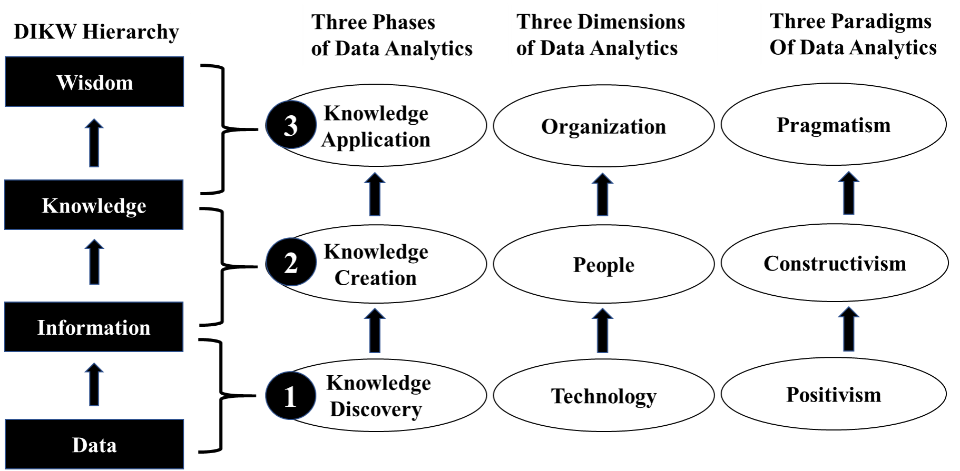
Analytics Process in Light of DIKW
Notes:
Data Analytics process is a process of knowledge discovery, knowledge creation, and knowledge application.
There has been much attention paid to step one given the rapid advance in machine learning and big data.
However, people tend to pay little attention to the importance of steps 2 and 3.
We need to balance technology with humanity. After all, technology is just a tool which is a means to an end not the end itself.

Slide 7
Tacit Knowing (Polanyi, 1966)
Tacit Knowledge | Explicit Knowledge
Subjective | Objective
Knowledge of experience (body) | Knowledge of rationality (mind)
Simultaneous knowledge (here and now) | Sequential knowledge (there and then)
Analog knowledge (practice) | Digital knowledge (theory)
Notes:
The distinction between tacit and explicit knowledge was eloquently explained and argued half a century ago by the scientist turned philosopher Michael Polanyi.
He famously stated that “We can know more than we can tell.”
Tacit knowledge is embodied within our personhood and cannot be explicitly codified.
Explicit knowledge is what we can tell and what can be explicitly codified.
What we can tell is only a small portion of what we know.

Slide 8
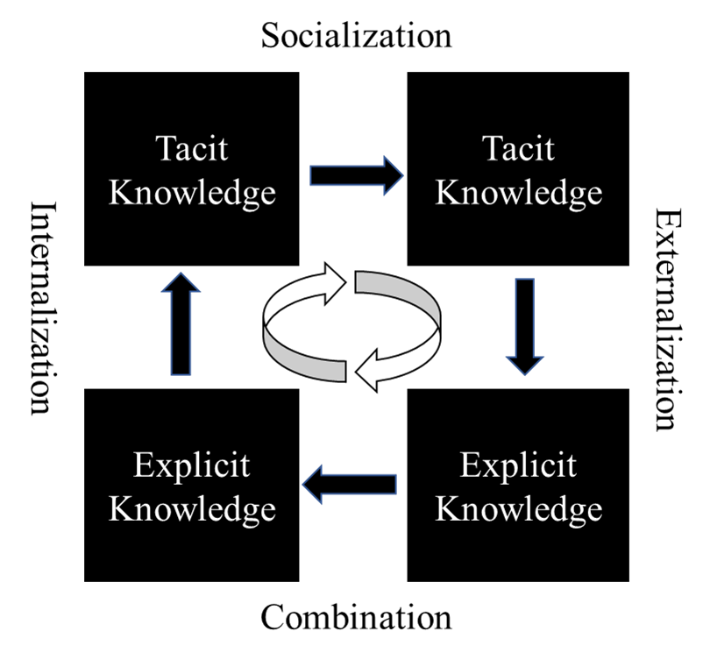
Knowledge Conversion (Nonaka & Takeuchi,1995)
Notes:
Nonaka and Takeuchi’s knowledge conversion theory is also known as SECI model. This theory draws upon the success stories of Japanese companies, Polanyi’s tacit knowing, and Eastern philosophy, in particular, the Zen Buddhism. Knowledge can be created through these four conversion process.
Socialization represents the process of knowledge sharing through collaboration and engagement. It stresses in-person interaction.
Externalization represents the process of codifying tacit knowledge for dissemination and application
Combination represents the process of aggregation and consolidation of explicit knowledge from various sources.
Internalization is the process of digesting explicit knowledge based on personal experience and making it your own.

Slide 9
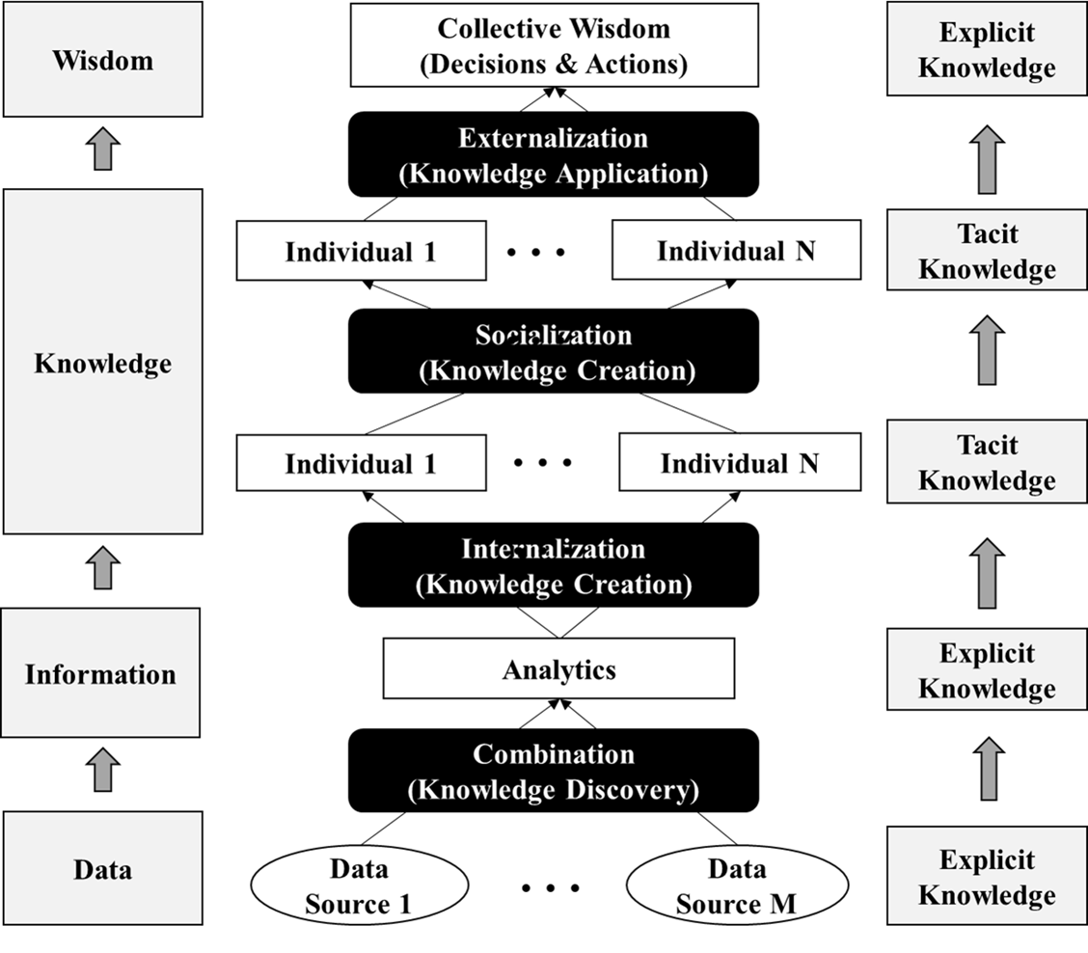
Knowledge Conversion Applied to Data Analytics Process
Notes:
As stated earlier, data analytics is a process of knowledge discovery, creation, and application.
The knowledge discovery process is a technical one in that it takes explicit knowledge in the form of data from various sources and utilizes computing power to discover hidden patterns, trends, and anomalies. This is the combination process in the SECI model.
Individual team members then interpret the discovered explicit knowledge and internalize it by incorporating their personal experiences. In addition, the collaboration of team members will help each person gain additional perspectives and further enrich their understanding. This is the knowledge creation process involving both internalization and socialization.
Finally, The team applies the knowledge created to the problem situation by formulating a potential solution or an improvement plan. This process externalizes the internalized tacit knowledge and codify it so that the specific actions and steps can be taken to solve a problem.

Slide 10
Conclusions
Data Analytics is not just number crunching using machine learning and big data technology
Knowledge management is much more than uploading documents to SharePoint
Knowledge discovery through machine learning is only the first step in data analytics
Knowledge creation comes from human collaborations
Knowledge application is the ultimate goal of data analytics and knowledge management
Notes:
These takeaway points are simple and straightforward. However, people tend to give up common sense to the fascination and hype of powerful technology.

Slide 11
Implications
Data Analytics Curriculum Design
Balanced coverage of both hard and soft skills
Hands-on practical projects and final capstone project
Seminars by domain experts (healthcare, financial, etc.)
Data Analytics Practices
Build interdisciplinary analytics team
Emphasize human engagement and collaboration
Future Research
Empirical evidence to support the model
Further refinement and operationalization of the model
Notes:
What we learn from this conceptual model can inform the curriculum design and the practice of data science and analytics.
Further research is also needed to provide empirical evidence and to refine and operationalize the model for practical applications.

Slide 12
References
Ackoff, R. L. (1989). From data to wisdom. Journal of applied systems analysis, 16(1), 3-9.
Davenport, T. H., & Harris, J. G. (2007). Competing on analytics: The new science of winning: Harvard Business Press.
Davenport, T. H., & Prusak, L. (1998). Working knowledge: How organizations manage what they know: Harvard Business Press.
Duhon, B. (1998). It's all in our heads. Inform, 12(8), 8-13.
Nonaka, I., & Takeuchi, H. (1995). The knowledge-creating company: How Japanese companies create the dynamics of innovation: Oxford university press.
Polanyi, M. (1966). The tacit dimension. London: The University of Chicago Press.
Rowley, J. (2007). The wisdom hierarchy: Representations of the DIKW hierarchy. Journal of information science, 33(2), 163-180.
Scarborough, H., Swan, J., & Preston, J. (1999). Knowledge management - The next fad to forget people? Paper presented at the Proceedings of European Conference on Information Systems, Copenhagen.
Wang, C. (2018). Integrating data analytics and knowledge management: A conceptual model. Issues in Information Systems, 19 (2), 208-216.
Zeleny, M. (2006). From knowledge to wisdom: On being informed and knowledgeable, becoming wise and ethical. International Journal of Information Technology & Decision Making, 5(04), 751-762.
Notes:
This slide lists references mentioned in the presentation. The paper with the full list of references is available from the following link:
http://www.iacis.org/iis/iis_articles.php?volume=19&issue=2
Thank you for your participation.

